Slide 1





Deep Learning based Vulnerability Detection: Are We There Yet
Saikat Chakraborty, Rahul Krishna, Yangruibo Ding, Baishakhi Ray
Columbia University, New York
Notes:
Hi everyone, today I am going to present our paper Deep Learning Based Vulnerability Detection : Are we there yet. In this paper, we investigated current deep learning based vulnerability detection techniques and their limitations in detecting real world vulnerabilities. We systematically identified, categorized and studied the limiltations, and proposed some intuitive solution. The goal of this paper is to shed light on the insufficiencies of the current techniques. Before moving onto the detail of the presentation, let us quickly revisit

Slide 2
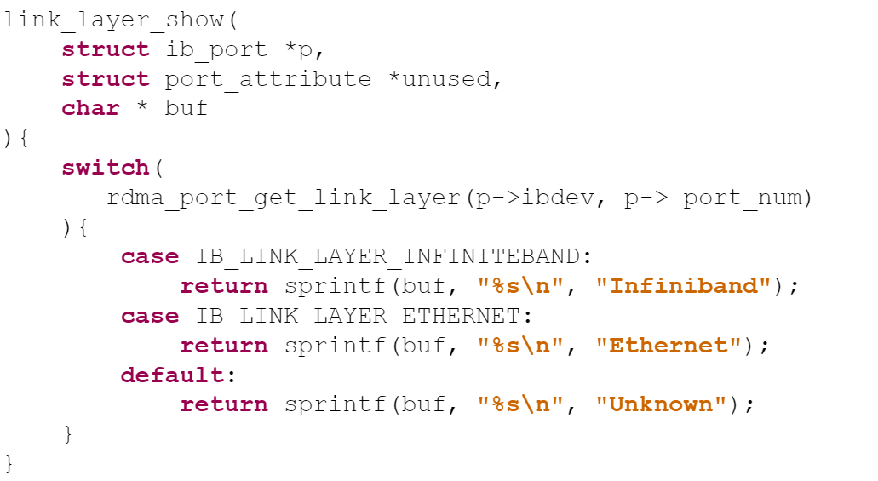
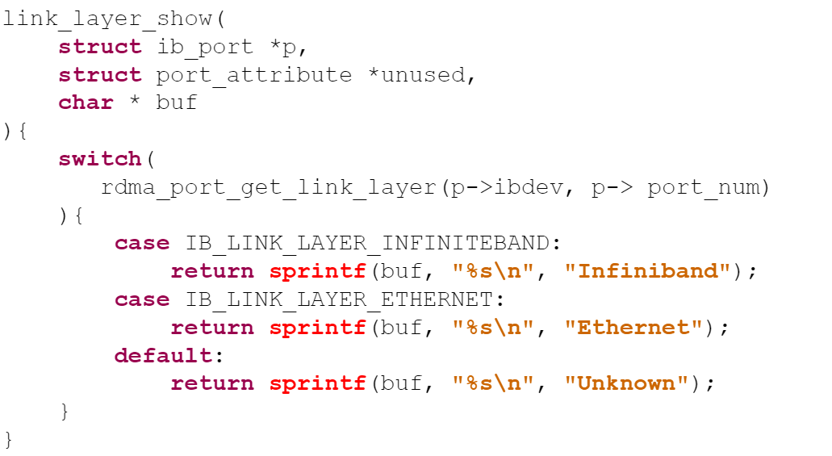
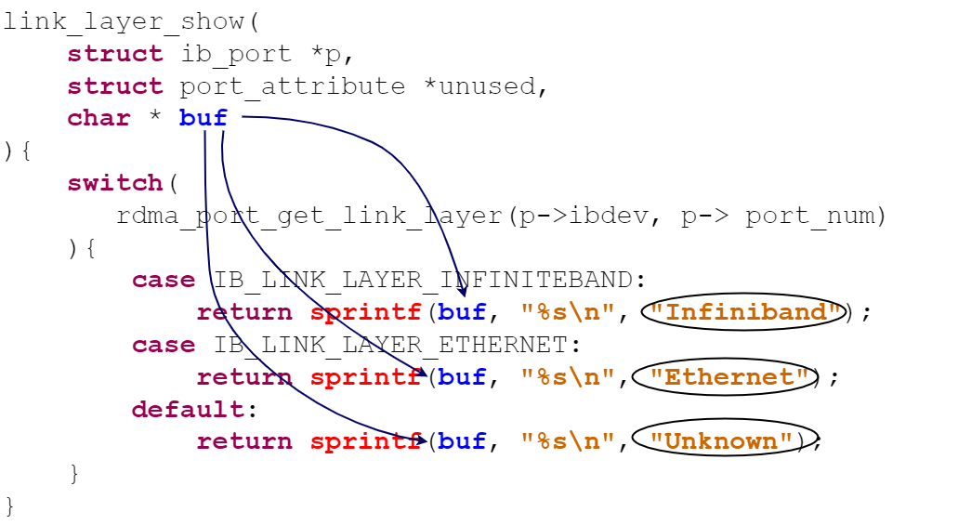
Source Code Vulnerability
Flaws in the code that creates a potential risk of compromising security.
Could allow hackers to take advantage of code by attaching an endpoint
Extract data
Tamper software
Erase memory
Notes:
Source Code Vulnerability. Source code vulnerabilities are flaws in the code theat creates potential risk compromising security of the software, which could allow hackers to take advantage of code by attacking the endpoint to potential steal data, temper code, erase memory and so on
For instance, this is a vulnerable code.
Since these sprint functions write to a buffer
Of unknown length, it could overwrite other important or safety critical content in the memory.

Slide 3
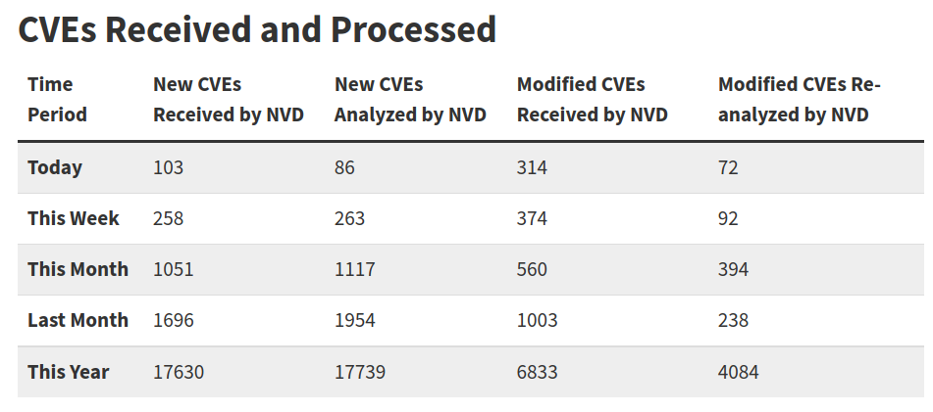
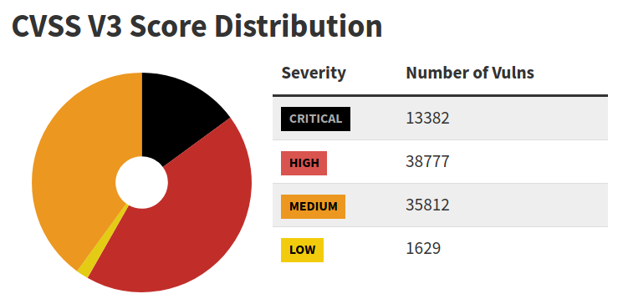
Why Vulnerability Detection?
CVE: Common Vulnerabilities and Exposures
National Vulnerability Database - 17 November 2021
Notes:
The more the world is becoming reliant on high tech softwares, the more our safety, security , and privacy are becoming dependent on the secure source code.
This is a snapshot of the vulnerabilities reported to National vulnerability database.
In October 2021 alone, around 1700 CVEs are reported and processed by NVD.
Majority of the CVEs in NVD are critical and high severity flaws. Most of these vulnerabilities are detected, identified and reported post-deployment. Thus it is very important for us to build tools that can identify vulnerabilities in pre-deployment phase, ideally during coding phase.

Slide 4
Why Vulnerability Detection?
30x
25x
20x
Relative Cost of Bug Fixing
15x
10x
5x
0x
50%
55%
60%
65%
Requirement/
Architecture
Coding/
Unit Testing
Integration
Testing
System
Testing
Production/
Post-Release
Notes:
Since relative cost of fixing a flaw in coding phase much less than that of productions or post deployment phase.

Slide 5
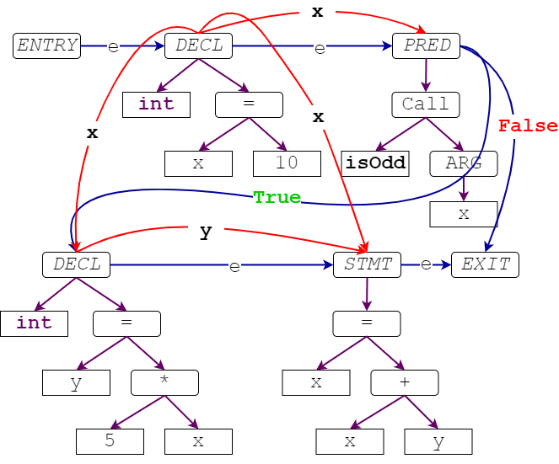

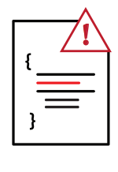

Vulnerability Detection – Static Approach
Does not assume test cases.
Considers all the paths in control and data flow graph.
Notes:
Nevertheless, To detect vulnerabilities during coding phase most suitable approach is static analysis based approach. Where an analyzer takes
In the code and any other syntactic, semantic, or functional metadata available,
And predicts whether the code is vulnerable or not.
These approaches do not assume any test cases,
And consideres all possible paths int the control and dataflow graphs.

Slide 6
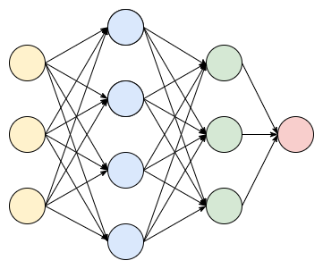
Deep Learning Based Vulnerability Detection
Trained from large collection of annotated data.
Usually a Code Classification Problem.
Notes:
A deep learning based Vulnerability detector implements such an analyzer using a Deep Neural Network.
Such a network is trained on large collection of annotated vulnerability data
And formulates the problem as code classification problem.

Slide 7




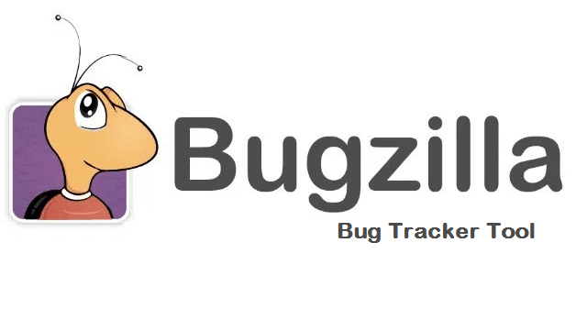





Deep Learning Based Vulnerability Detection - Pipeline
Curate and Preprocess
Data
Deep Learning Based Vulnerability Detector
Design
Model
Training
Notes:
A typical pipeline on Deep Learning Based Vulnerability Detection involve
Curating and preprocessing the data from different databased
Designing and building a suitable model
Training the model
And finally evalting the model on vulnerability detection.

Slide 8
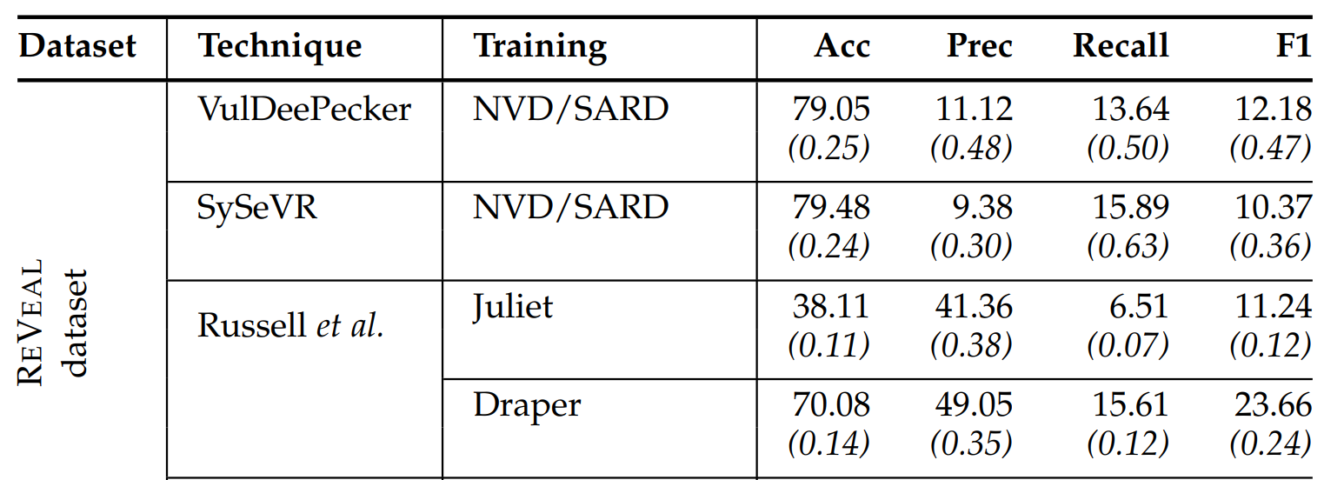
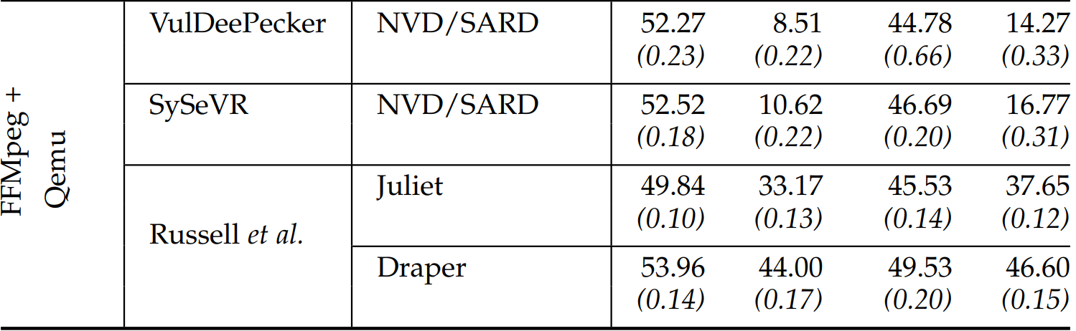
Results on Detecting Real World Vulnerabilities
ReVeal
*Chromium
and
*Debian
FFMPeg + Qemu
(Devign)
FFMPeg
and
Qemu
* Collected from Issue trackers (Jira, BugZilla) of Chromium and Debian
Notes:
With that spirit, we evaluated existing vulnerability detection techniques in two real world vulnerability datasets. Among these two datasets, we collected ReVeal data from the Issue trackers of Chromium and Debian projects.
And here are the results of these techniques in these two datasets.
Evidently, the performance of these approaches in these two datasets are far from being effective and reliably used in development pipeline. We have identified

Slide 9
Issues with Existing Approaches
Issues With Datasets
Issues with Models
Notes:
Two major source of problems to explain these results. And in the rest of the talk we are going to discuss these problems.

Slide 10
Issues with Existing Approaches
Issues With Datasets
Issues with Models
Notes:
First, let is discuss issues with existing datasets,

Slide 11
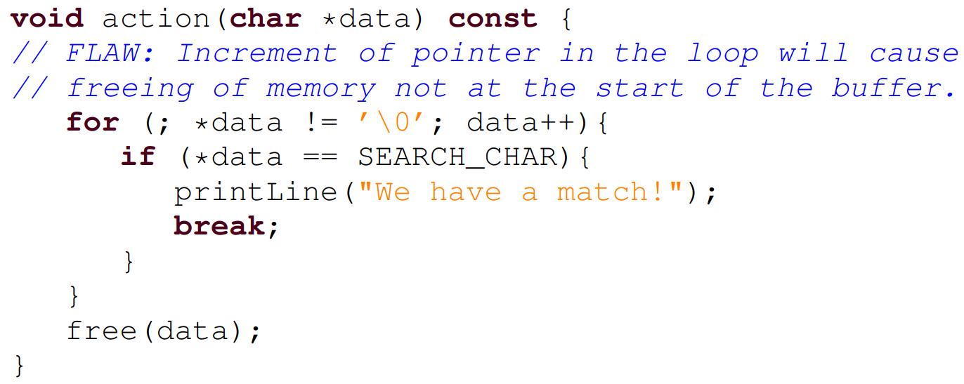
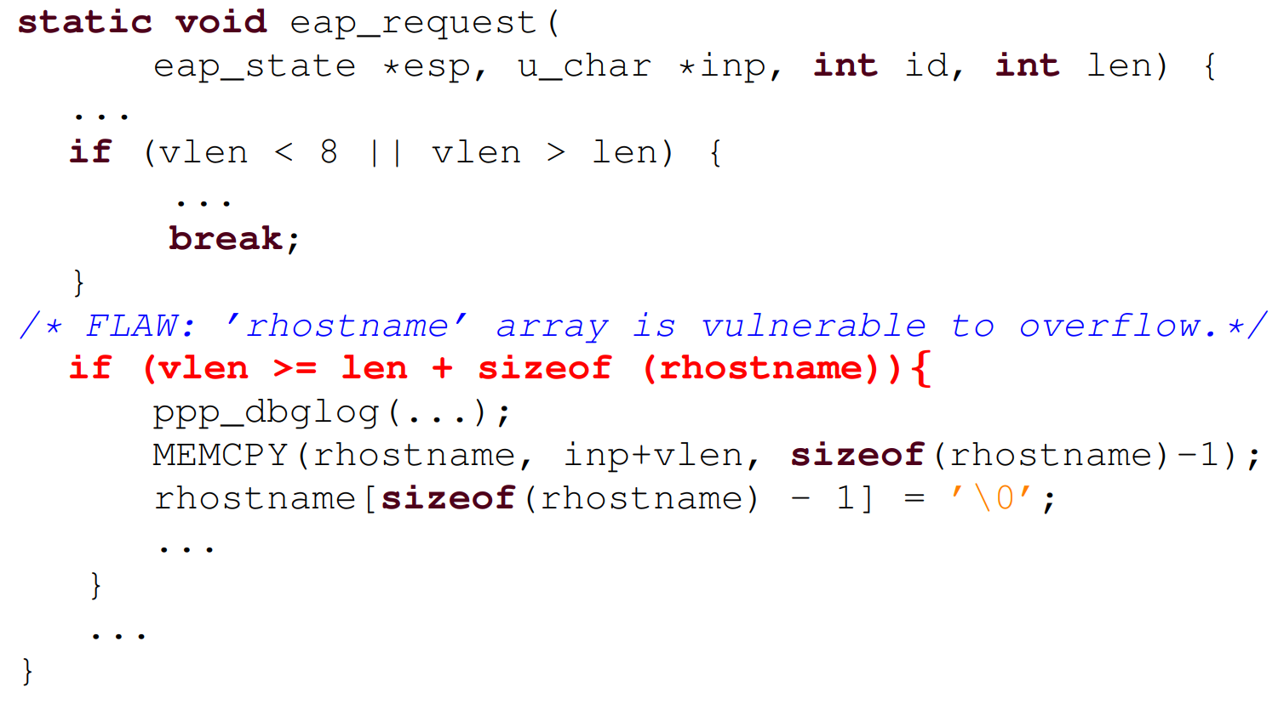
Issues with Training Data
Real Vulnerability
CWE 761 - Example
Synthetic Vulnerability
CVE2020-8597 From Debian Issue tracker
Notes:
A vulnerability detection tool intended for identifying real world vulnerability must be trained on real world vulnerable code. A lot of the existing techniques are trained on synthetic of semi-synthetic vulnerable code Where the vulnerability is often isolated.
For instance, this code is a buffer overflow vulnerability, here the vulnerable code is isolated. In real world, it is unrealistic to find such isolated code. Real world code are much more complex than this
For instance, in this code, the code contains a lot of other things than the vulnerability itself. In addition, the vulnerability pattern is much more obscure and complex. Thus, we conjecture that the TRAINING DATA should be real world source code. That is any Deep Learning model should be trained on source code examples that resembles the real world source code.

Slide 12
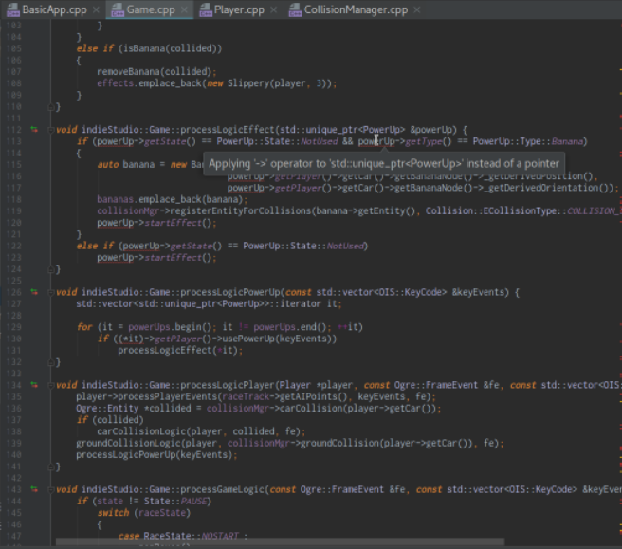
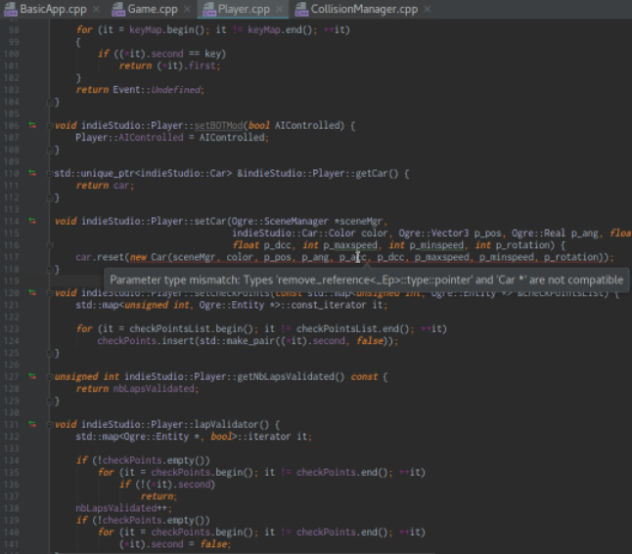
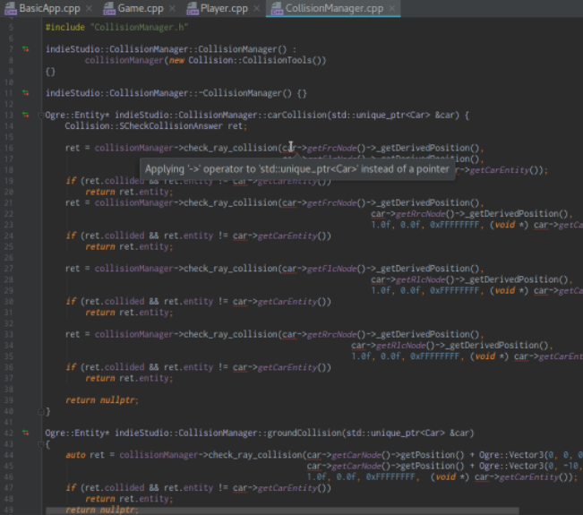
Issues with Evaluation Data
Notes:
Furthermore, vulnerability is not so common. A typical snapshot of a project contains hundreds of file with some functions in each file. VERY FEW of those functions are usually vulnerable. Thus in a real world development setting the proportion of vulnerable and non-vulnerable code become very imbalanced. We emphasize that to realistically understand the usability of a tool, the tool MUST BE evaluated in real world imbalanced settings.

Slide 13
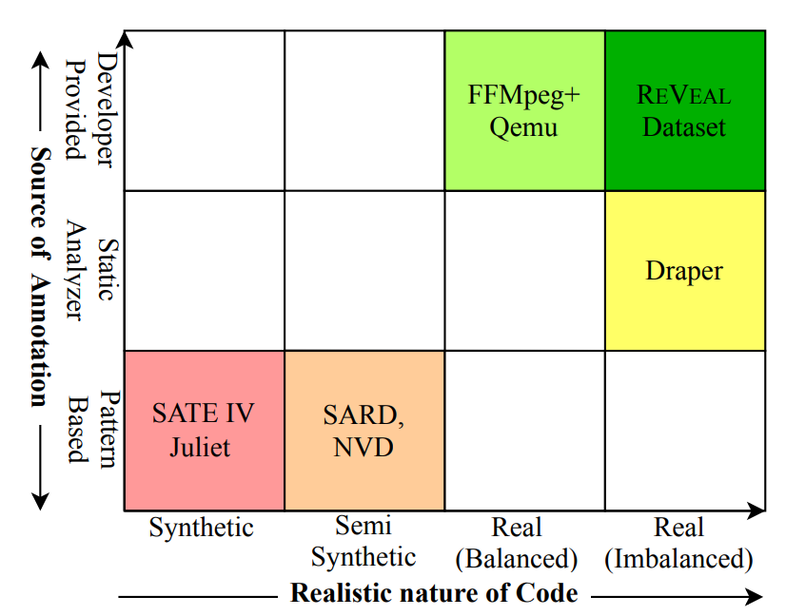
A Comprehensive picture of Existing Datasets
Devign
Dataset [1]
[1] Devign – Zhou et. al. NeurIPS – 2019
[2] Russell et. al. – ICMLA 2018
[3] VulDeePecker – Li et. al. – NDSS 2018
[4] SySeVR – Li et. al. IEEE TDSC 2021
Draper
Dataset [2]
SATE-IV
Juliet
[2, 3]
NVD*
SARD+
[3, 4]
Notes:
With these conjectures, we categorized the existing datasets into different categories. In one exis we are showunbg the realistic nature of the source code. And another axis shows the source of annotation. To be realistically used, we propose using real world dataset, where the source code is coming from real world projects and the annotations are coming from the developers.

Slide 14
Issues with Existing Dataset – Lessons we Learned!
Deep Learning tools for “Real World Vulnerability” detection should learn from real world data.
Tools trained on “Isolated” vulnerable code may only detect “Isolated” vulnerable code, which is often impractical.
To be practical, real world vulnerabilities should be “Annotated” by real human being. Tools built on automated annotators may only learn the annotators algorithm.
Evaluation data should closely resemble the real evaluation setting of the developers, every tools and technique should be evaluated on highly imbalanced dataset.
Notes:
Thus the lessons we learned while analyzing the characteristics of existing dataset are
Deep Learning tools for “Real World Vulnerability” detection, should learn from real world data.
Tools trained on “Isolated” vulnerable code may only detect “Isolated” vulnerable code, which is often impractical.
To be practical, real world vulnerabilities should be “Annotated” by real human being. Tools built on automated annotators may only learn the annotators algorithm.
Evaluation data should closely resemble the real evaluation setting of the developers, every tools and technique should be evaluated on highly imbalanced dataset.

Slide 15
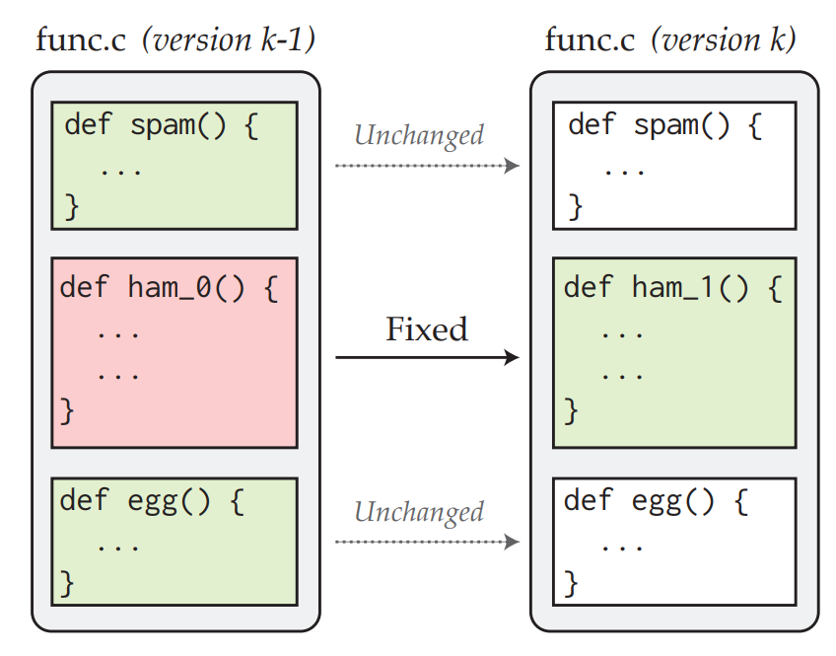
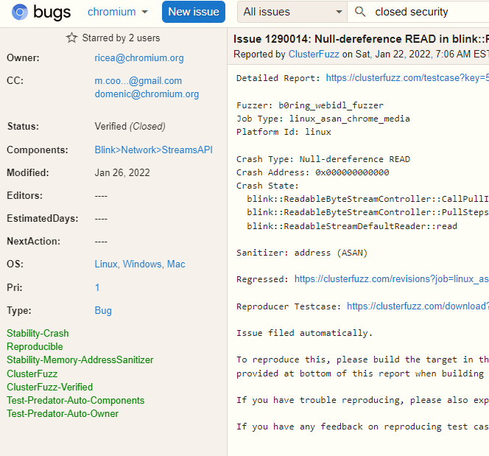
How we collected ReVeal Data
Notes:
With all these lessons learned we designed a prototype of data collection. First, we go to the issue tracker of a project.
Then we identified the issues with explicitly tagged as security flaw, or vulnerability, etc. we also make sure the the issue is resolved and there is a patch attached to the issue.
For every file changed in that patch, we identified the functions that are changed. We annotate all the functions that are unchanged as non-vulnerable. For the functions that are changed, we annotate the version before the patch as vulnerable and the version after the patch as non-vulnerable.

Slide 16
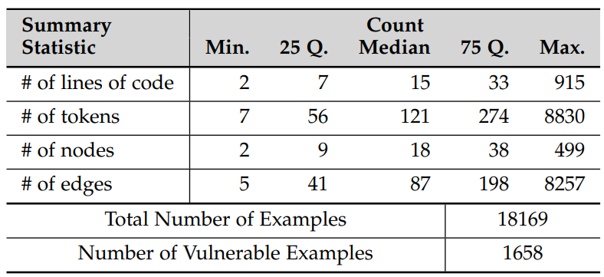
How we collected ReVeal Data
Notes:
In that way, we collected a dataset containing more than 18000 functions among which there are 1658 functions are annotated as vulnerable.

Slide 17
Issues with Existing Approaches
Issues With Datasets
Issues with Models
Notes:
Now, let us move onto the next part, where we investigate the existing model and identify the issues with existing models.

Slide 18
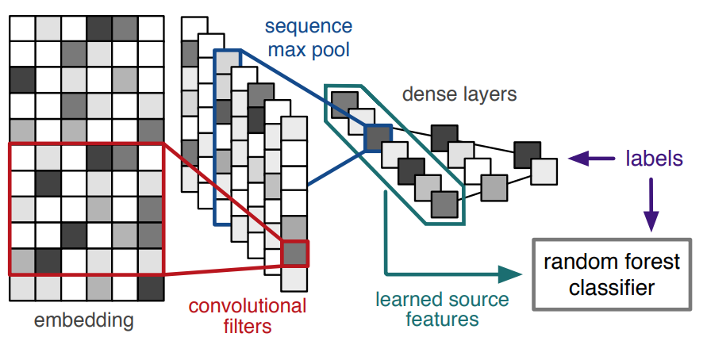
Choice of Models
Russell et. al.
Notes:
Here is a function, which, as we have seen earlier is a vulnerable function.
We used Russell et. al.’s CNN based model to classify this function. And the model INDEED classified this function as VULNERABLE

Slide 19

Choice of Models
Notes:
However, when we poked the model a little bit, and added some explain ability in the model, we see that the model thinks that *****these portion****** of the code is responsible for the vulnerability. We conjecture that even when the model is doing the right thing, it is doing it for a wrong reason. Which proves the model is picking up the wrong signals from the data and becomes brittle.

Slide 20
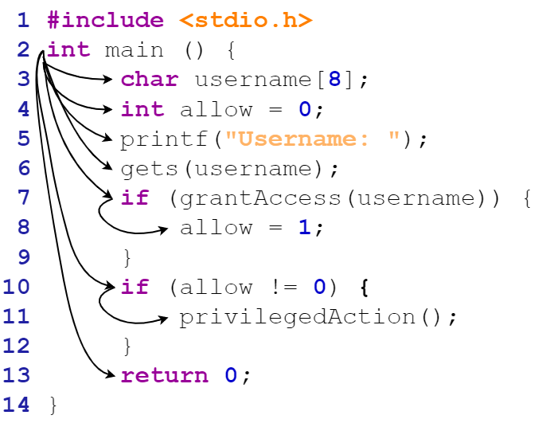
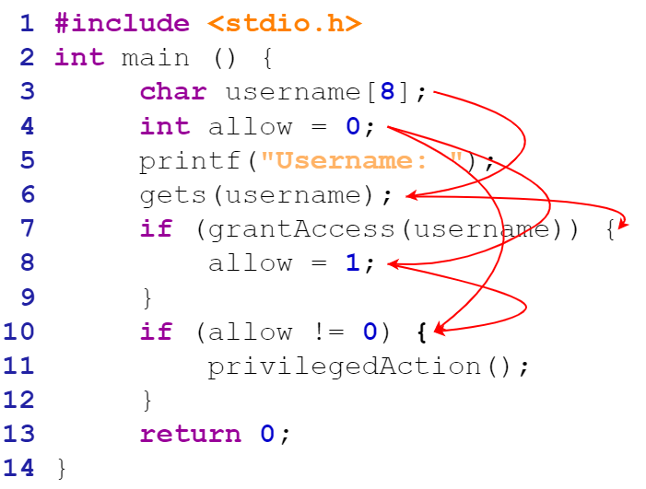
Choice of Models
Russell et. al.
Notes:
In fact, if we look closely, we see that a lot of the existing models are sequence based model. We hypothesize that using a sequence based models lacks the capacity to analyze the
Different structural information that has played a very important role in detecting vulnerability.

Slide 21
Issues with Existing Models – Lessons we Learned!
Token sequence based models may not be the best choice for modeling code.
The model should have the capacity to incorporate information about different dependencies and flows in the code, either explicitly or implicitly.
Token names (i.e. variables, apis) should not be abstracted or hidden from the model since those often contain valuable information for vulnerability analysis.
Notes:
So, the lessons we learned while investigating different models, are
Token sequence based models may not be the best choice for modeling code.
The model should have the capacity to incorporate information about different dependencies and flows in the code, either explicitly or implicitly.
Token names (i.e. variables, apis) should not be abstracted or hidden from the model since those often contain valuable information for vulnerability analysis. With these lessons,

Slide 22
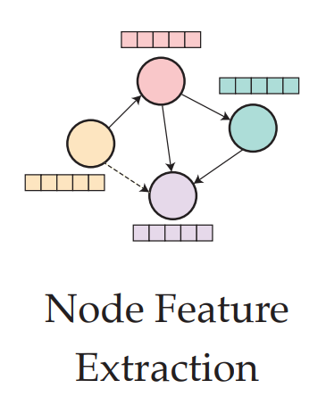
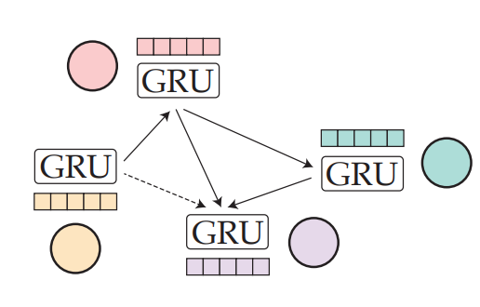
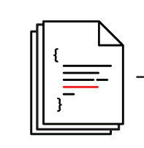
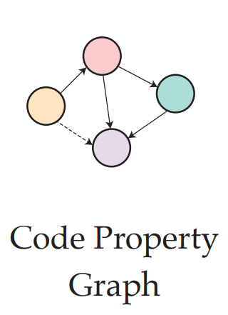
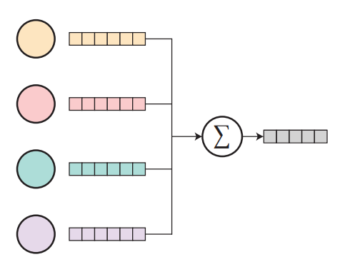
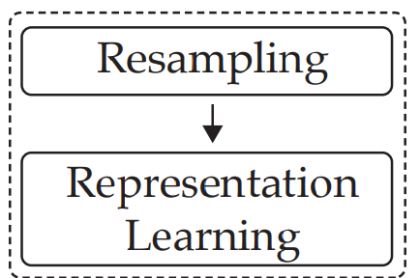

ReVeal
Training Data
GGNN
Code Property Graph
Node Features
Trained ReVeal
Graph Embedding
Notes:
We designed Reveal, a graph based tool to detect vulnerabilities in real world software projects.
Given training data containing vulnerabile and non-vulnerable code, we extract code property graph, which is a graph that encodes all structural relationships between code components.
From the code property graph, we extract initial node features for every node.
Then we use Graph Neural Network to learn the node features from the graph structure.
Once node features are learned, we aggregate those to generate a graph level features
Given a collection of such graph level features, we do resampling to reduce the imbalance bias,
and train our tool ReVeal

Slide 23
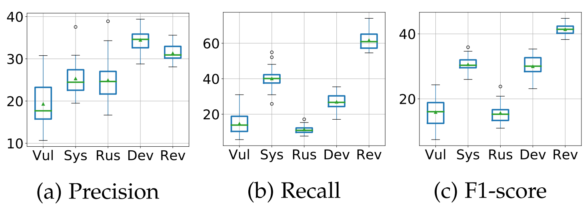
ReVeal – Results on ReVeal Dataset
VulDeePecker
SySeVR
Russell et. al.
ReVeal
VulDeePecker
Devign
SySeVR
VulDeePecker
Russell et. al.
ReVeal
SySeVR
Devign
Russell et. al.
ReVeal
Devign
Notes:
Here is the result of ReVeal on detecting vulnerabilities in our collected dataset.

Slide 24
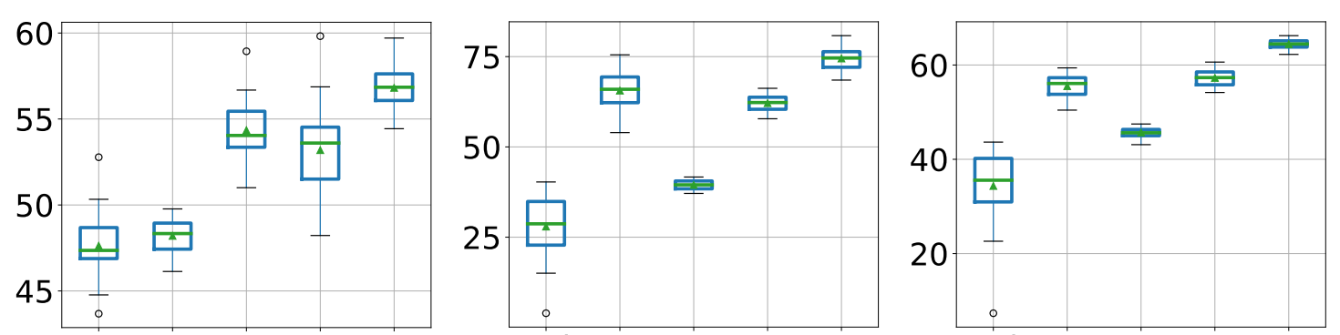
ReVeal – Results on Devign Dataset
VulDeePecker
SySeVR
Russell et. al.
ReVeal
VulDeePecker
Devign
SySeVR
VulDeePecker
Russell et. al.
ReVeal
SySeVR
Devign
Russell et. al.
ReVeal
Devign
Notes:
Here is the result of ReVeal on detecting vulnerabilities on Devign Dataset

Slide 25
ReVeal – F1 Scores in Datasets
ReVeal Data
Devign Data
Sequence Based Model
Graph Based Model
Sequence Based Model
Graph Based Model
VulDeePecker
VulDeePecker
SySeVR
SySeVR
Russell et. al.
ReVeal
Russell et. al.
ReVeal
Devign
Devign
Notes:
If we look closely, we can see
That Graph based models exhibit higher performances than that of sequence based models.

Slide 26
Summary
Deep Learning Based Vulnerability Detection is
Far from being perfect, even
Far from being effectively usable.
Both Training and Evaluation data should be carefully chosen.
Models should be chosen cautiously to facilitate Code Analysis.
“Static” analysis on Functionality, and
“Dynamic” analysis on execution traces
should be incorporated to design more robust model.
Notes:
Finally, to summatize the main take away from the papers is
1.
2.
3.
4.

Slide 27
Thanks!
Notes:
Thanks you for listening to the talk

